Slide 1
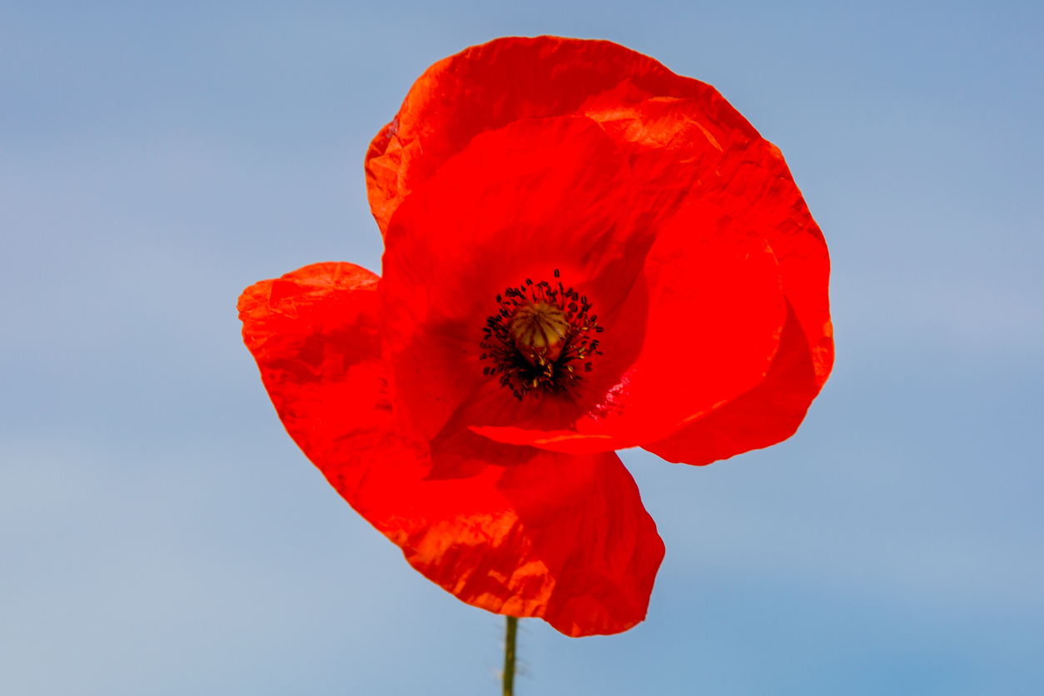
Remembrance day Project
Billy Lavigne

Slide 2
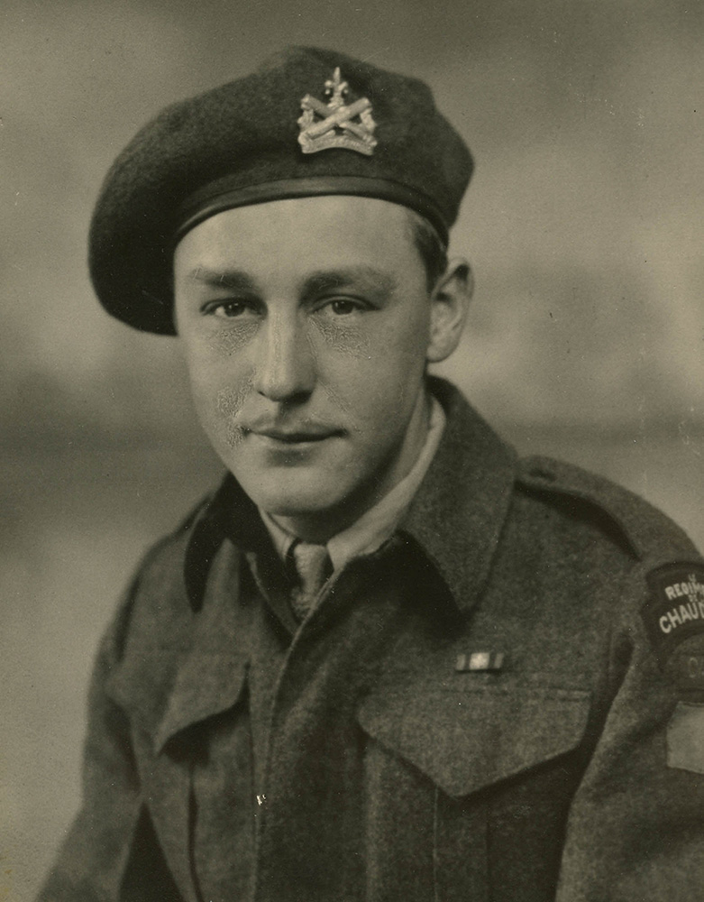
Lorenzo Tremblay
Lorenzo Tremblay fought in the battle of normandy (now referred to as D-Day) on June 6th 1944, operating a .303 light machine gun and a flamethrower.

Slide 3
Highway of Heroes - The Trews
The Trews are a canadian band, whos popularity can be heavily linked to their song “Highway of Heroes”, a truly beautiful song who’s creation is tied with Nichola Goddard, the first female veteran to die while serving, whos passing during the war of afghanistan.

Slide 4
When you hear “Rememberance” what do you think of?
When I hear the word remembrance, I think of the hard-fought battles that thousands of canadians took in hopes of ending a world war, so that peace and harmony could be restored in humanity. For many of those veterans, they were unsure if they would be able to make it back home to their families, and for some, they never returned. Those brave soldiers made a true sacrifice that shall not be forgotten.

Slide 5
What meaning does remembrance day have to you?
My great-grandfather fought in a war, and as someone who wasn’t able to get to know him that well, I try to spend remembrance day thinking about him, and thinking about everything that veterans like him sacrificed for our country, putting their lives on the line to fight for us.

Slide 6
Why do we have remembrance day?
We have remembrance day to honor not only the numerous men and women who never returned to their families, but to also honor those who died in war and who were never named, and the soldiers who did come back home safely. War is a harsh thing, one that’s unforgiving to those despite their differences.

Slide 7
How will you show your remembrance this year?
I plan to spend a majority of the day tomorrow wearing a poppy, even at my house, as it’s not just a fancy icon as some may see it as, it’s a symbol of the hard fought battles that were faced for our country. If possible, i’d wish to visit the grave of a war veteran, and lay down some flowers in their honor.

